Slide 1
Malaria cases in Colombia 2015 - 2023
Cruz De La Rosa, Gressy; Kong De Puga, Fatima Cecilia; Salawu, Ayotomiwa; Singh, Vikram Jeet; Wilches Vega, Juan Diego

Slide 2
Contents
Overview 3,4,5
Decisions 6
Acquisition 7
-Data source, Data scope, Anonymity Measures 7
Timing 8
Analysis 9
-Cases by sex 9
-Cases by Social Security 10
-Cases by Ethnicity 11
-Cases by Migrant Status 12
-Cases by Pregnancy status 13
-Cases by hospitalization 14
-Cases by Age Group 15
-Cases by Department 16
Data Transformation, Audit and Desing 17
Assumptions 18
References 19

Slide 3
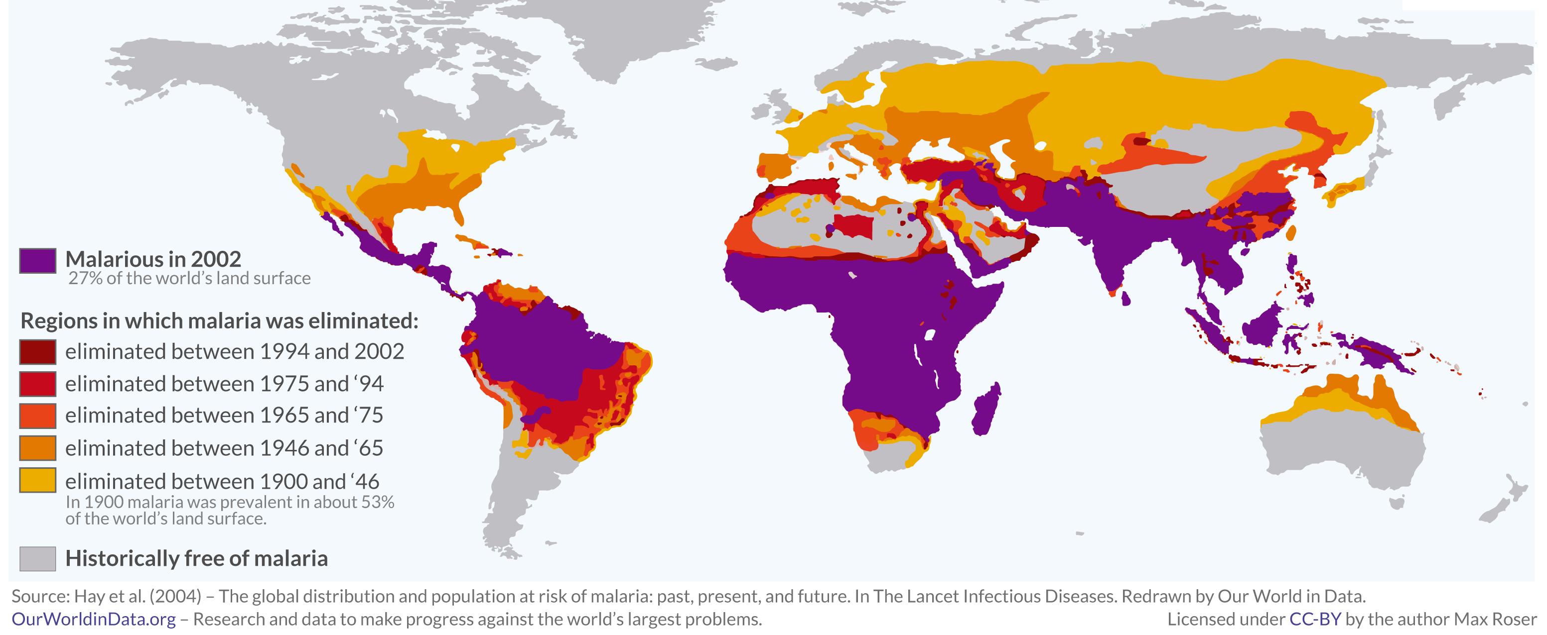
Overview
Malaria is a significant global public health challenge, particularly in equatorial regions.
WHO reports a reduction in global malaria cases and deaths from 2000 to 2019.
Estimated cases decreased from 238 million to 230 million during this period.

Slide 4
Overview
Incidence rate dropped from 80 to 57 cases per 1000 people at risk.
Mortality rate decreased from 25 to 10 deaths per 100,000 people at risk.
Malaria-related deaths globally declined from 736,000 in 2000 to 409,000 in 2019.
Concentrated in countries like Brazil, Colombia, Guyana, Haiti, Peru, and Venezuela.
Increase in cases from 2015 to 2019, particularly in Brazil, Colombia, Guyana, Nicaragua, and Panama.
COVID-19 in 2020 complicated malaria control efforts, impacting prevention and treatment programs.

Slide 5
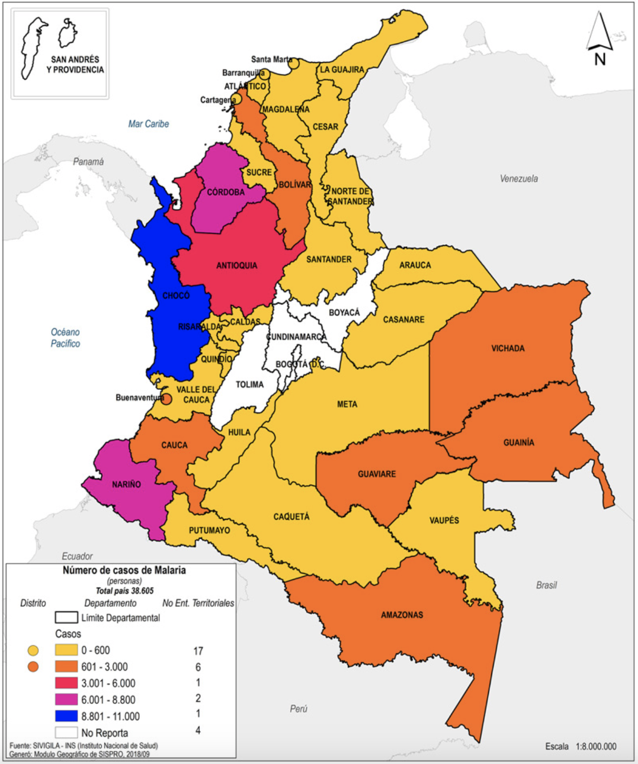
Overview
Five main active transmission foci in regions including the Pacific, Amazon-Orinoco, Magdalena Medio, and the Venezuela border.
Malaria transmission occurs in unstable zones with varying endemo-epidemic patterns.

Slide 6
Decisions
Malaria cases declined from 2005 to 2014.
A spike in cases reported in 2015, attributed to the conflict in Venezuela leading to migration into Colombia and neighboring countries.
Purpose of Data Analysis:
Planning interventions:
Aiming for target-specific strategies.
Resource Allocation:
Enhancing efficiency in resource allocation based on identified patterns.
Strategic Planning for Intervention:
Utilizing data insights for planning interventions.
Addressing age, gender, and ethnicity-specific aspects to tailor malaria control efforts effectively.
Key Focus Areas:
Age Group Distribution:
Aiming to identify the most affected age group.
Sex-based Classification:
Seeking to determine which sex has higher cases of the disease.
Ethnicity and Healthcare Coverage:
Analyzing to identify the ethnic group most affected and assess healthcare coverage implications.

Slide 7
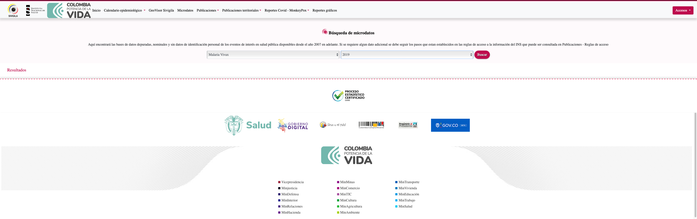
Acquisition
Data Source:
Obtained from the national institute of health of Colombia.
Detailed information on individuals who suffered from the disease.
Data Scope:
Comprehensive variables gathered for analysis.
Enables a detailed examination of key factors related to malaria cases in Colombia.
Anonymity Measures:
Unique codes were assigned to each individual.
Elimination of all identifiers to maintain individual anonymity

Slide 8

Timing
This research explored reported Malaria cases in Colombia between 2015 and 2023 by sex, ethnicity, age distribution, and health coverage.

Slide 9
Analysis
Cases by Sex
Year | F | M | Gran Total
2015 | 9838 | 14317 | 24155
2016 | 13975 | 19741 | 33716
2017 | 8938 | 12961 | 21899
2018 | 11886 | 17817 | 29703
2019 | 14822 | 21618 | 36440
2020 | 15702 | 23353 | 39055
2021 | 14742 | 20742 | 35484
2022 | 17775 | 25668 | 43443
2023 | 270 | 418 | 688
Grand Total | 107948 | 156635 | 264583

Slide 10
Analysis
Cases by Social Security
S = Subsidized
P = Retired
N = Not covered
I = Unknown status
E = Special category (military, police officers, public teachers)
C = Contributory

Slide 11
Analysis
Cases by Social Ethnicity
1 = Indigenous
2 = Romani
3 = Raizal (Colombian Caribbean islands)
4 = Palenque (Northern swamps of Colombia),
5 = Afro
6 = Others

Slide 12
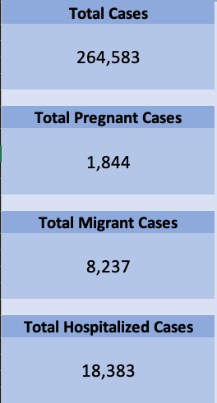
Analysis
Cases by Migrant Status

Slide 13
Analysis
Cases by Pregnancy Status

Slide 14
Analysis
Cases by Hospitalization

Slide 15
Analysis
Cases by Age Group

Slide 16
Analysis
Cases by Department

Slide 17
Transformation
Structured database
Recognizable and organized columns
Aggregation: multiple to single
Audit
Data for all years was available
Records for all the variables
Data was cleaned, trimmed, and formatted
Design
Dataset translated from Spanish to English
Some variables were deleted
Metadata sheet

Slide 18
Assumptions
Increasing Malaria Cases:
Despite Ministry of Health efforts, Malaria cases in Colombia have continued to rise annually from 2015 to 2023.
Migration from Venezuela was initially considered the main factor, but data reveals a low proportion of cases among migrants compared to Colombians.
Both, possibly acting as a larger reservoir for mosquitoes, may contribute to the sustained increase.
Ethnic and Geographical Trends:
Indigenous people and Afro communities exhibit a steady increase in malaria cases, contrasting with the "Other" population.
Migrants, concentrated in cities, show higher malaria rates, while Indigenous and Afro communities, located in less accessible areas with poor conditions, experience high incidence, but steadier.
Age Distribution and Risk Factors:
Malaria cases follow a common pattern seen in other affected countries.
Higher risk among young adults due to outdoor activities and active nightlife.
Children aged 5 and younger are also vulnerable.

Slide 19
References
Arena, P. M., Corugedo, E. F., & Yepez, J. G. y J. F. (n.d.). Los migrantes venezolanos brindan oportunidades económicas a América Latina. IMF. Retrieved December 9, 2023, from https://www.imf.org/es/News/Articles/2022/12/06/cf-venezuelas-migrants-bring-economic-opportunity-to-latin-america
Cardona-Arias, J. A., Salas-Zapata, W. A., & Carmona-Fonseca, J. (2019). Determinación y determinantes sociales de la malaria: Revisión sistemática, 1980-2018. Revista Panamericana de Salud Pública, 43, e39. https://doi.org/10.26633/RPSP.2019.39
Recht, J., Siqueira, A. M., Monteiro, W. M., Herrera, S. M., Herrera, S., & Lacerda, M. V. G. (2017). Malaria in Brazil, Colombia, Peru and Venezuela: current challenges in malaria control and elimination. Malaria Journal 2017 16:1, 16(1), 1–18. https://doi.org/10.1186/S12936-017-1925-6
Rogerson, S. J. (2017). Management of malaria in pregnancy. The Indian Journal of Medical Research, 146(3), 328. https://doi.org/10.4103/IJMR.IJMR_1304_17
Rocha, J. O. (2020, August 19). Las etnias y la pandemia en Colombia [Text]. Universidad de los Andes - Colombia - Sitio oficial. https://uniandes.edu.co/es/noticias/economia-y-negocios/la-etnias-y-pandemia-en-colombia

Slide 20


